Slide 1
The Polish Banking Sector 2015/2016
May 2016

Slide 2
Poland -basic information
Population: 38,4 millions (6th in the EU)
Area: 312 679 km2 (6th in the EU)
GDP: 548,003 bn USD ( 2014-9th in the EU)
GDP
per capita (PPP): 24 882 USD (2014 68% of EU average)
Source: Eurostat, World Bank

Slide 3
Poland -basic information
GDP Growth Poland/ EU
Unemployment Poland/ EU
Source: Eurostat

Slide 4
Złoty exchange rate
Source: NBP

Slide 5
Polish Foreign Trade in EUR bn
Source: Ministry of Economy

Slide 6
Polish Foreign Trade in EUR bn
Source: Ministry of Economy

Slide 7
Governement Debt vs GDP
Source: Central Statistical Office (GUS)

Slide 8
Inflation in Poland (y/y)
Source: Central Statistical Office (GUS)

Slide 9
Banks in Poland 2014/2015
Commercial banks
(including 2 regional co-operative banks): 38/38
Branches of credit institutions: 28/27
Co-operative banks: 565/561
Number of service outlets,
branches, sub-branches, branch offices: 15.602/14.496
Number of employees: 174.668/ 170.936
Market share of five largest banks by assets 48,49%/48,78%
Market share of five largest banks by deposits 47,43%/54,98%
Data by Polish Financial Supervision Authority for the days: 31/12/2014 - 31/12/2015

Slide 10
Largest Polish Banks
PKO Bank Polski SA
Bank Pekao SA (Unicredit Group)
BZ WBK (Santander Group)
ING Bank Śląski SA (ING Group)
mBank SA (Commerzbank Group)

Slide 11
Polish banks' assets in bn PLN, EUR
Source: Polish Financial Supervision Authority

Slide 12
Polish banks' assets in bn PLN, EUR
Source: Polish Financial Supervision Authority

Slide 13
Banking sector Assets/GDP (%) 2014
Source: EBC

Slide 14
Polish banks' own funds (in bn PLN, EUR)
Source: Polish Financial Supervision Authority

Slide 15
Net and gross profits (EUR bn)
Source: Polish Financial Supervision Authority

Slide 16
ROA, ROE in Polish banking sector
Source: Polish Financial Supervision Authority

Slide 17
Stable Country-Robust banking sector
During the recent financial crisis Polish bank have not required any public support.
The sector is stable, healthy and with good perspectives for growth.
The sector remained higly profitable in 2014. Profits were lower in 2015.
Profits in 2016 will be much lower due to new tax on assets.
Source: Polish Financial Supervision Authority
CAR Polish banking sector

Slide 18
Impaired loans ratio in %
Source: Polish Central Bank, Polish FSA

Slide 19
Impaired loans ratio in %
Source: Polish Central Bank, Polish FSA

Slide 20
Credits and deposits non financial sector in EUR bn
Deposits non-financial sector
Credits non-financial sector

Slide 21
Mortgage Credits in PLN bn
 | 2007 | 2008 | 2009 | 2010 | 2011 | 2012 | 2013 | 2014 | Jan '15 | Dec'15 | March '16
CHF/PLN | 2,16 | 2,8 | 2,76 | 3,16 | 3,63 | 3,38 | 3,38 | 3,54 | 4,01 | 3,94 | 3,90

Slide 22
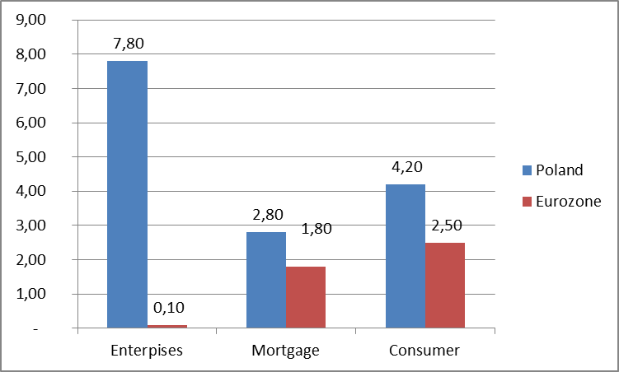
Credit growth rate in 3Q 2015
Credit growth rate (%) in Poland & Eurozone in 3Q 2015
The rate of enterprise, mortgage credit & consumer credit growth in Poland was visibly higher than in the Eurozone
Source: Polish Financial Supervision Authority

Slide 23
Banking cards in Poland
Source: NBP Polish Central Bank

Slide 24
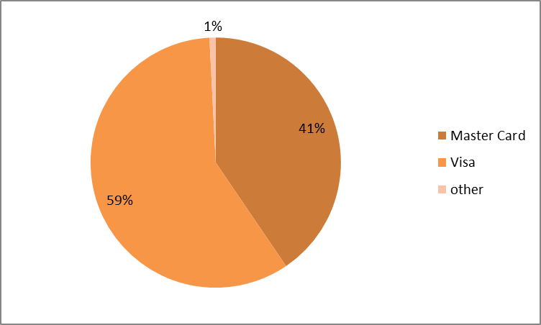
Structure of Polish card market 2015

Slide 25
Internet banking in Poland
Source: Polish Bank Association

Slide 26
State-of the-art mobile banking technology
BLIK standard
Steady growth of m-banking users
BLIK- new standard of mobile payments in Poland-common project of seven banks: Alior Bank, Bank Millennium, Bank Zachodni WBK, ING Bank Śląski, mBank, PKO BP Credit Agricole PL and National Clearing Chamber KIR SA.
solution allows for payment in brick-and-mortar and internet shops and for withdrawing money from ATMs
launched in February 2015
currently 1,4 million customers

Slide 27
Recent developments in politics
(after elections in October 2015)
THE POLISH BANK ASSOCIATION
ul. Kruczkowskiego 8
00-380 Warsaw
tel. +48 22 48 68 180
www.zbp.pl
Source: The Sejm.

Slide 28
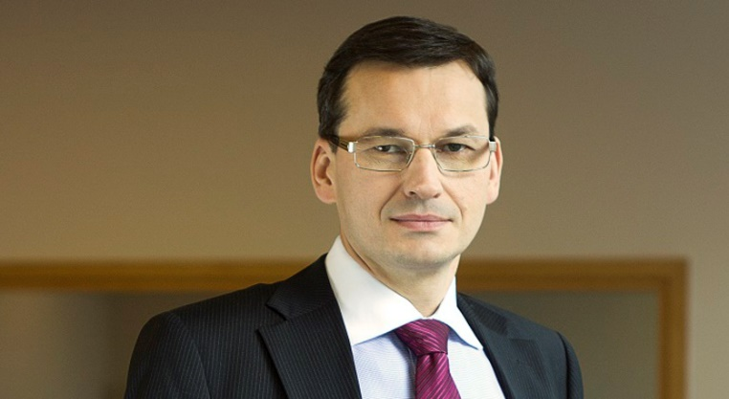
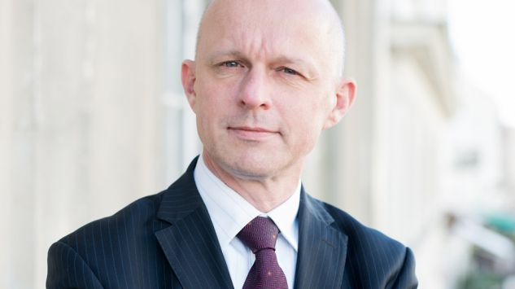
Recent developments in politics
THE POLISH BANK ASSOCIATION
Key players
Mateusz Morawiecki
Deputy Prime Minister and Minister of Development in the cabinet of Beata Szydło.
From 2007 to 2015 he served as chairman of Poland's 3rd. largest bank, Santander's Bank Zachodni WBK.
Paweł Szałamacha
Minister of Finance in the cabinet of Beata Szydło.
Former Deputy Minister of Treasury.
Founder and Chairman of the Sobieski Instytut, a think tank.
ul. Kruczkowskiego 8
00-380 Warsaw
tel. +48 22 48 68 180
www.zbp.pl

Slide 29
Financial institutions levy in Poland-I
On January 15, 2016, the act on tax on assets of certain financial institutions was introduced in Poland. It came into force on February 1, 2016.
The law introduces a wealth tax, in which subject to taxation are assets of certain financial institutions, i.e.:
• domestic banks,
• branches of foreign banks,
• branches of credit institutions,
• cooperative banks,
• domestic insurance companies,
• domestic reinsurance companies,
• branches and main branches of foreign insurersand reinsurers,
• loan institutions.

Slide 30
Financial institutions levy in Poland-II
.
The tax base thresholds :
• banks, branches of banks, credit institutions and cooperative banks – assets exceeding the value of PLN 4 billion (however decreased by banks’ own funds and certain financial assets like e.g. treasury bonds, gathered by banks),
• insurers, reinsurers and their branches – exceeding PLN 2 billion (that value is calculated jointly for all taxpayers related or co-related directly or indirectly to one entity or a group of related entities),
• loan institutions – exceeding PLN 200 million (that value is calculated jointly for all taxpayers related or co-related directly or indirectly to one entity or a group of related entities).
Polish state banks and financial institutions being subject to liquidation, bankruptcy or compulsory administration are extempt from the tax
The tax will be collected on a monthly basis (beginning from February 2016) and the tax rate is set at the level of 0,0366% of the tax base.

Slide 31
Thank you for your attention
Questions, comments: pawel.pniewski@zbp.pl

