Slide 1


From Artificial Intelligence to Financial Inclusion
Moscow 3 april 2019

Slide 2
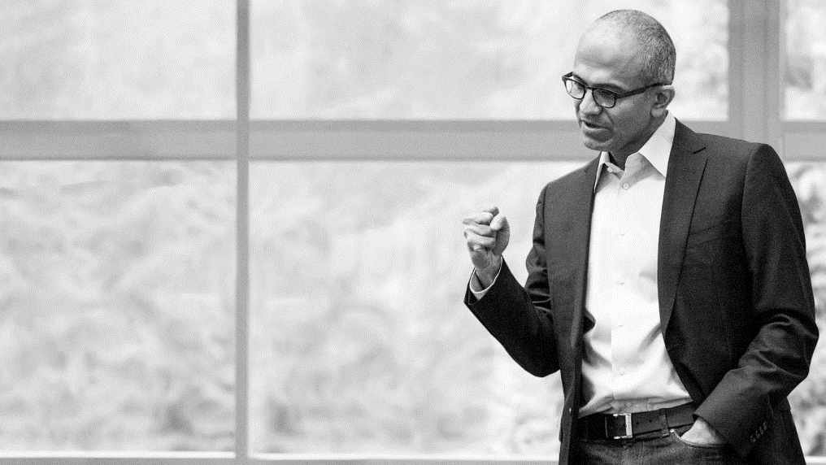
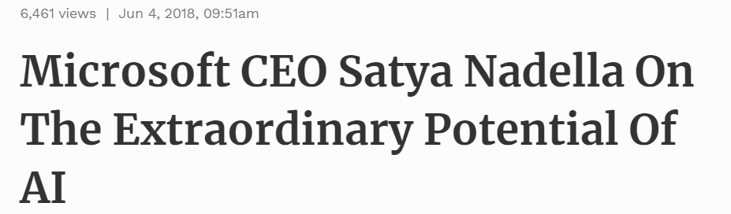
AI Is Going To Shape All Of What We Do
What is perhaps at the core of the experiences [and applications] we create, as well as our platform itself, is AI,” Nadella told the audience. “AI is the runtime that is going to shape all of what we do going forward in terms of the applications as well as the platform advances.”

Slide 3
Conversations reveal а lack of common definitions for Al — this is an example of the ‘AI effect'
No one can agree on what “artificial intelligence“ is or isn't
Machine learning isn’t AI!
Machine learning is a subset of AI
AI is really about augmented intelligence
Cognitive is the human aspect of AI
What we're
talking about is
deep learning – no one has achieved AI
Al effect
This lack of definitional clarity is illustrative of а well-documented phenomenon called the “Al effect", Essentially, this means the inability of observers to agree on what is, and isn't, intelligence and а tendency to conclude that the existing capabilities of computer programs are not “real” intelligence
Intelligence is whatever machines haven't done yet“
- Larry Tesler, 1970

Slide 4
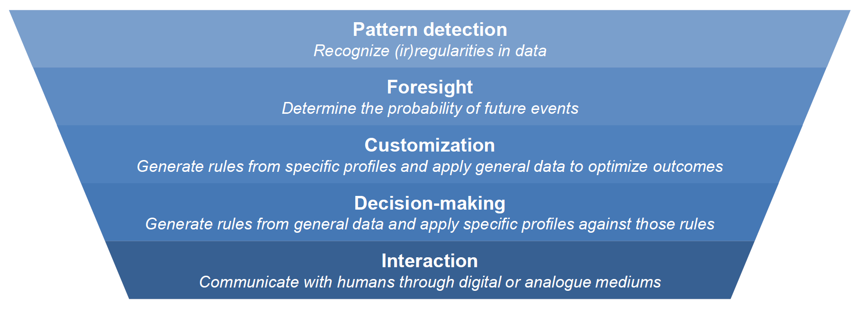
While no one can agree on what AI is, people clearly mean something when they use the term
When business people talk about АI, they typically are not talking about а particular technical approach or а well-defined school of computer science, rather they are talking about а set of capabilities that allows them to run their business in а new way.
At their core, these capabilities are almost always:
А suite of technologies, enabled by adaptive predictive power and exhibiting some degree of autonomous learning, that have made dramatic advances in our ability to use machines to automate and enhance:
Many applications of AI-driven technology use a combination of the above automations and enhancements

Slide 5
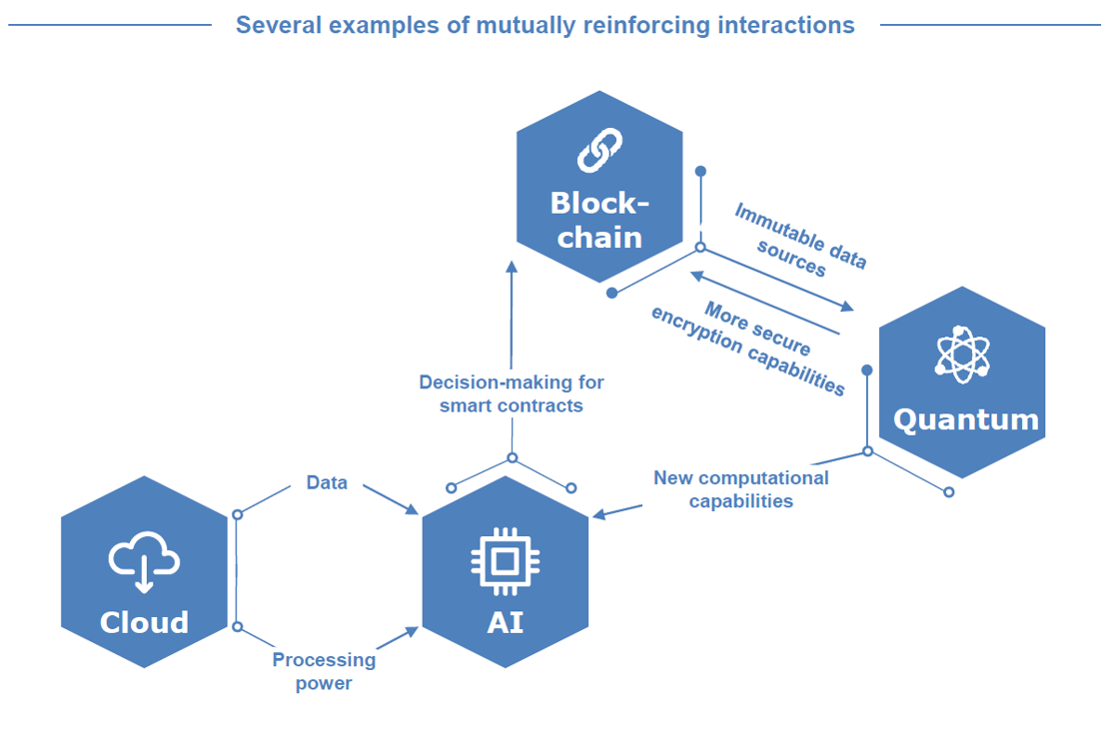
Al does not exist in а vacuum — its capabilities will be intertwined with the development of all other technological innovations
Advances in any one technology will increase the capabilities of an other technologies that interact with it
For example:
Blockchain offers а source of immutable data that does not require centralized verification, which could be critical for identity management
While quantum computing hold the potential to break many encryption methods today, it may also bring new and even stronger techniques that will take blockchain more secure
Advanced and different computation methods provided by quantum computing will allow Al to tackle new problems that were previously incalculable
АI will enable increasingly complex and automated smart contracts to be executed, allowing more blockchain use-cases to enter the mainstream
Cloud computing will provide both the data storage and the processing power necessary to train new Al models, in turn making cloud infrastructure а critical part of organizations
Notes:
Focus on АI alone is not sufficient to understand the myriad ways in which it could be used within financial institutions. Much like other disruptive technologies, Al is not а panacea, and must be understood within the context of an other technologies that will affect how businesses operate.
The potential list of interactions is endless, and will continue to develop and grow as these technologies mature and new disruptive technologies come to fruition.
Advances in any one technology will increase the capabilities of an other technologies that interact with it
Emerging technologies are mutually reinforcing, and the abilities of any one new technology are influenced by its interactions with other technologies

Slide 6
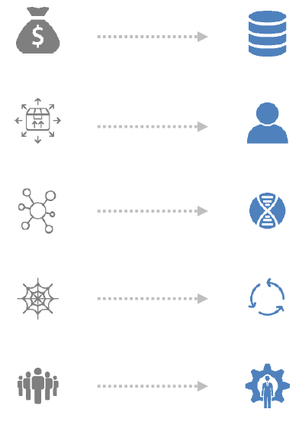
Al is altering the attributes necessary to build а successful business in financial services
And creates а new wave of transformation across the global financial services industry
Scale of assets
Scale of data
Economies of scale presented a cost
advantage
As AI drives operational efficiency, economies of scale
alone will not sustain cost advantages
Mass production
Tailored experiences
Physical footprint and standardized products
drove cost-effective revenue growth
As AI drives operational efficiency, economies of scale
alone will not sustain cost advantages
Exclusivity of relationships
Optimization and matching
Ability to have direct access to many markets and connections to investors was a critical differentiator
Connections are digitized, increasing the importance
of optimizing the best fit between parties
High switching costs
High retention benefits
High barriers to switching providers drove
customer retention
Continuously improving product performance to offer superior
customer outcomes and new value will keep clients engaged
Dependence on human ingenuity
Value of augmented performance
Processes scaled through additional
labour and functional training
The interplay of strengths across technology
and talent amplifies performance
This is placing legacy business models under pressure from those whose businesses are built around these new attributes

Slide 7

Al presents Banks and Fintechs with the opportunity to change their businesses in а multitude of ways ranging from incremental improvement to complete reinvention
from relatively conservative efforts to improve existing processes to bold bets on new capabilities and business models
Doing the same things, better
Doing something radically different
Leaner, faster operations
Tailored products and advice
Smarter decision-making
New value propositions
Using automation to improve the efficiency of business-as-usual processes
Reducing the cost of simple, routine processes, while maintaining or improving quality of experience
Personalizing interactions to more closely meet the unique needs of customers
Providing convenient, high-quality service, while maintaining scalability
Using advanced data science to optimize business outcomes (eg lower default rates)
integrating large volumes of data to derive better insights across business units (eg better capital allocation)
Differentiating offerings through new operating models and ways of working
Building brand new products, services and business models that use Al at the core

Slide 8
How will Banks Innovate and Evolve?
Augmented intelligence (bots/agents, robo-advisors, intelligent automation)
Advisory
Payments
Cards
Deposits
and lending
Non-Traditional Services
Social Networks
Micro Personalization
of Financial Experiences
Branch of the Future
(Virtual Presence, Augmented Reality, Seamless life integration)
Fintech partnerships
Digital ledgers and blockchain
Predictive analytics, IoT, big data
Notes:
greater competition, transparency and leading edge technology in the banking market
As data becomes radically easier
and cheaper to acquire, store, transfer and
analyze, more specialist business models
become viable.
Cледующей технологией, которая поднимет востребованность платежей, полагаю, будет интернет вещей (IoT)
Fintechs are here to stay - We cannot put the genie back in the bottle. The future is being wrought by technology, customer expectations, and the Fintechs. Banks are in a change or die scenario and they mostly know this.
Essential technologies are known - New technologies such as cloud, augmented intelligence, big data (customer insights), bots, robotic process automation, open API infrastructures, blockchain, and others are going to be central in the new infrastructure.
Invest in what is known - Banks should focus immediately on creating an agile platform with these technologies as essential elements.
Let quick to value be the guide - Banks should begin by deploying projects which are quick to market, deliver proven value, and leverage these essential technologies.

